Slide 1
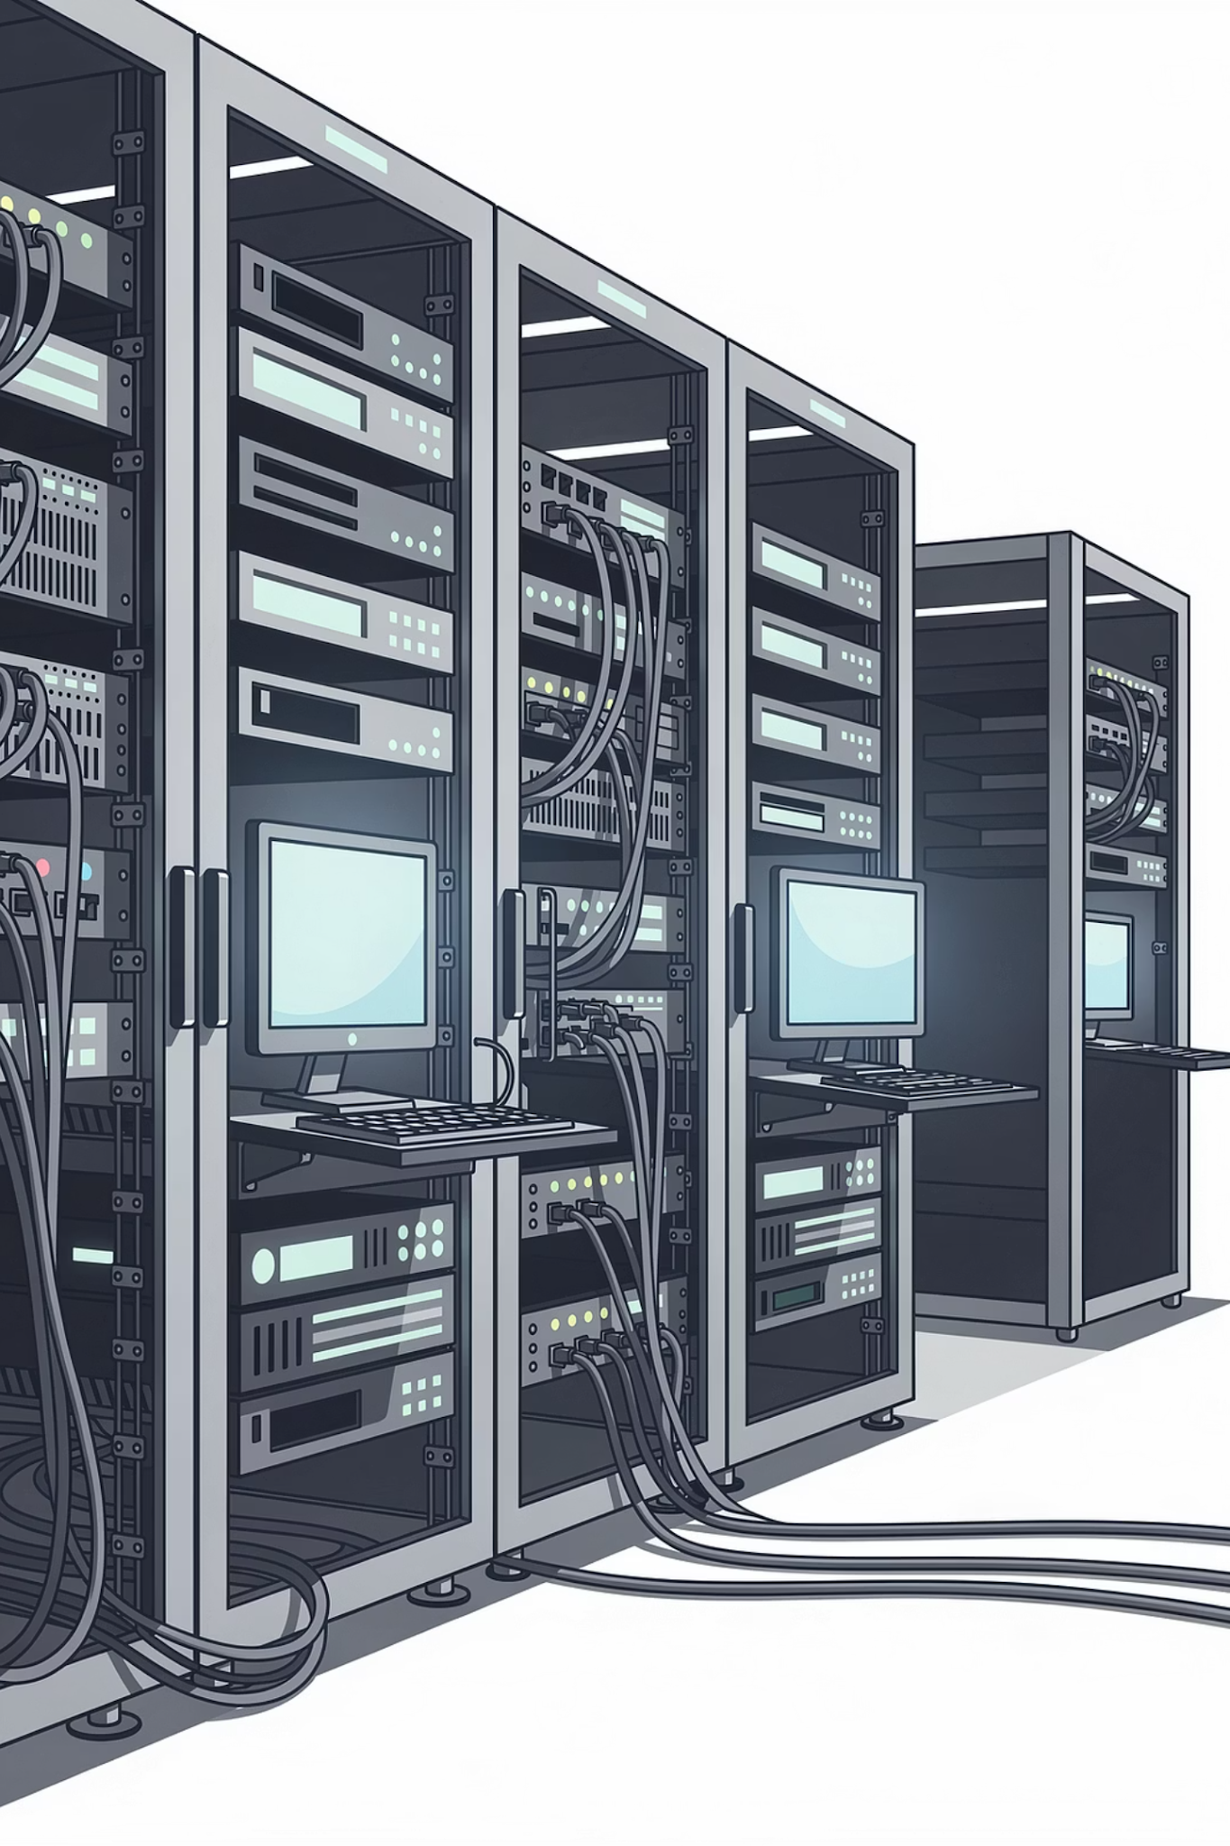

Monitoring, Logs & Reliability
Building Reliable Systems in DevOps
1

Slide 2
Session Agenda
01
02
What is Monitoring?
Logs vs Metrics vs Alerts
03
04
High Availability
SLA & Uptime
05
06
Real-World Failure Examples
Dashboard & Log Demo
07
08
Alert Flow
Monitoring Checklist
2

Slide 3
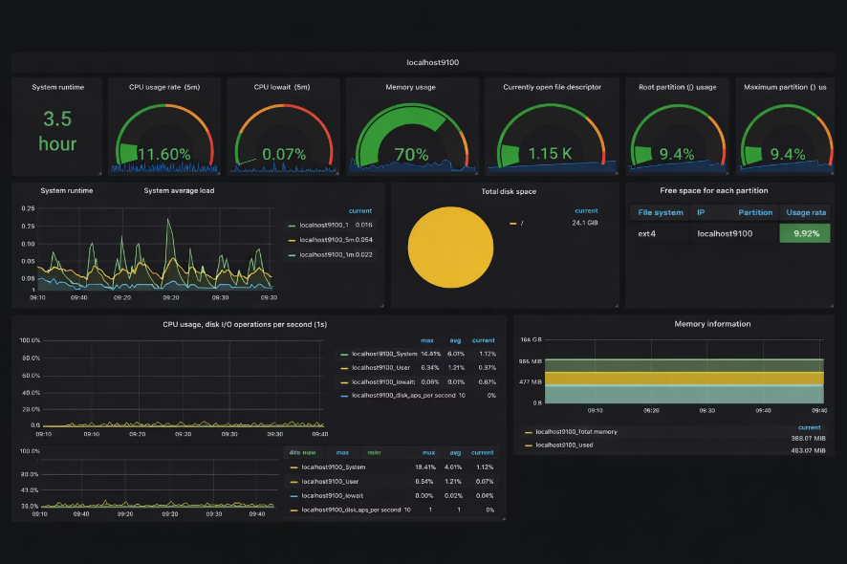
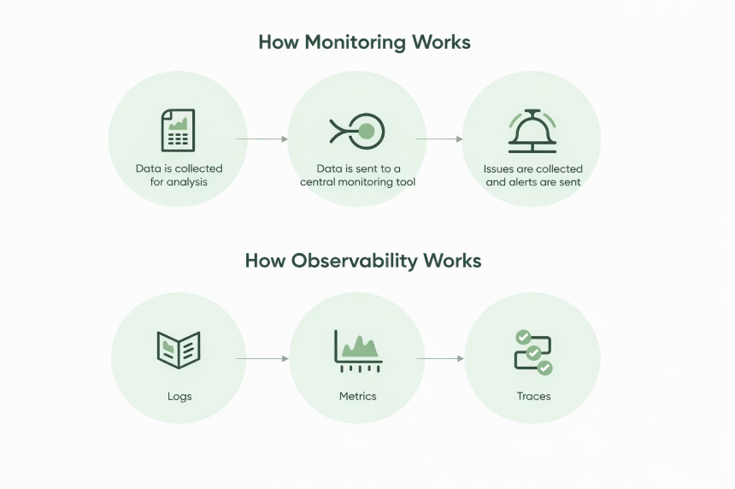
What is Monitoring?
Continuously observing system performance and health — detecting issues before users complain.
1
Servers
2
Applications
3
Databases
4
Network
5
User Traffic
3

Slide 4
Why Monitoring Matters
Without Monitoring
With Monitoring
Problems detected late
Users report issues first
Revenue loss
Early detection
Faster resolution
Improved reliability
Monitoring = Visibility into system health.
4

Slide 5

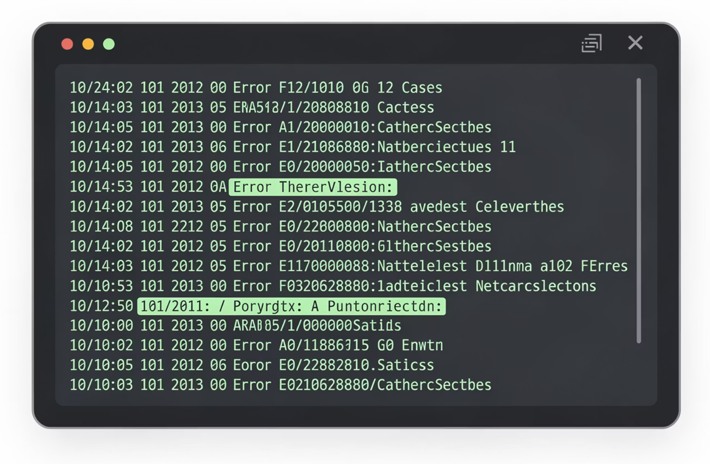
LOGS VS METRICS VS ALERTS
What are Logs?
User login
API request
Error message
Server restart
Logs are detailed event records generated by applications or systems.
Logs tell the story of what happened.
5

Slide 6
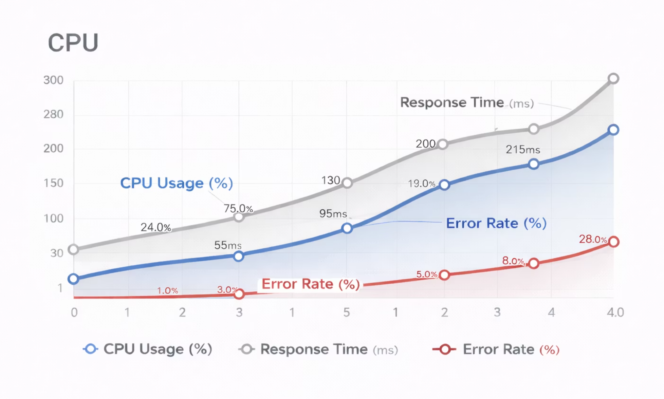
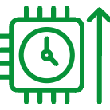
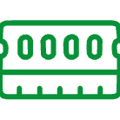


LOGS VS METRICS VS ALERTS
What are Metrics?
Metrics are numerical measurements over time.
CPU Usage (%)
Memory Usage
Response Time
Error Rate
Metrics show trends and performance.
6

Slide 7
LOGS VS METRICS VS ALERTS
What are Alerts?
Alerts are notifications triggered when something crosses a threshold — informing teams to take action.
CPU > 90%
Error Rate > 5%
Server Down
High compute load detected
Application instability warning
Critical availability failure
7

Slide 8
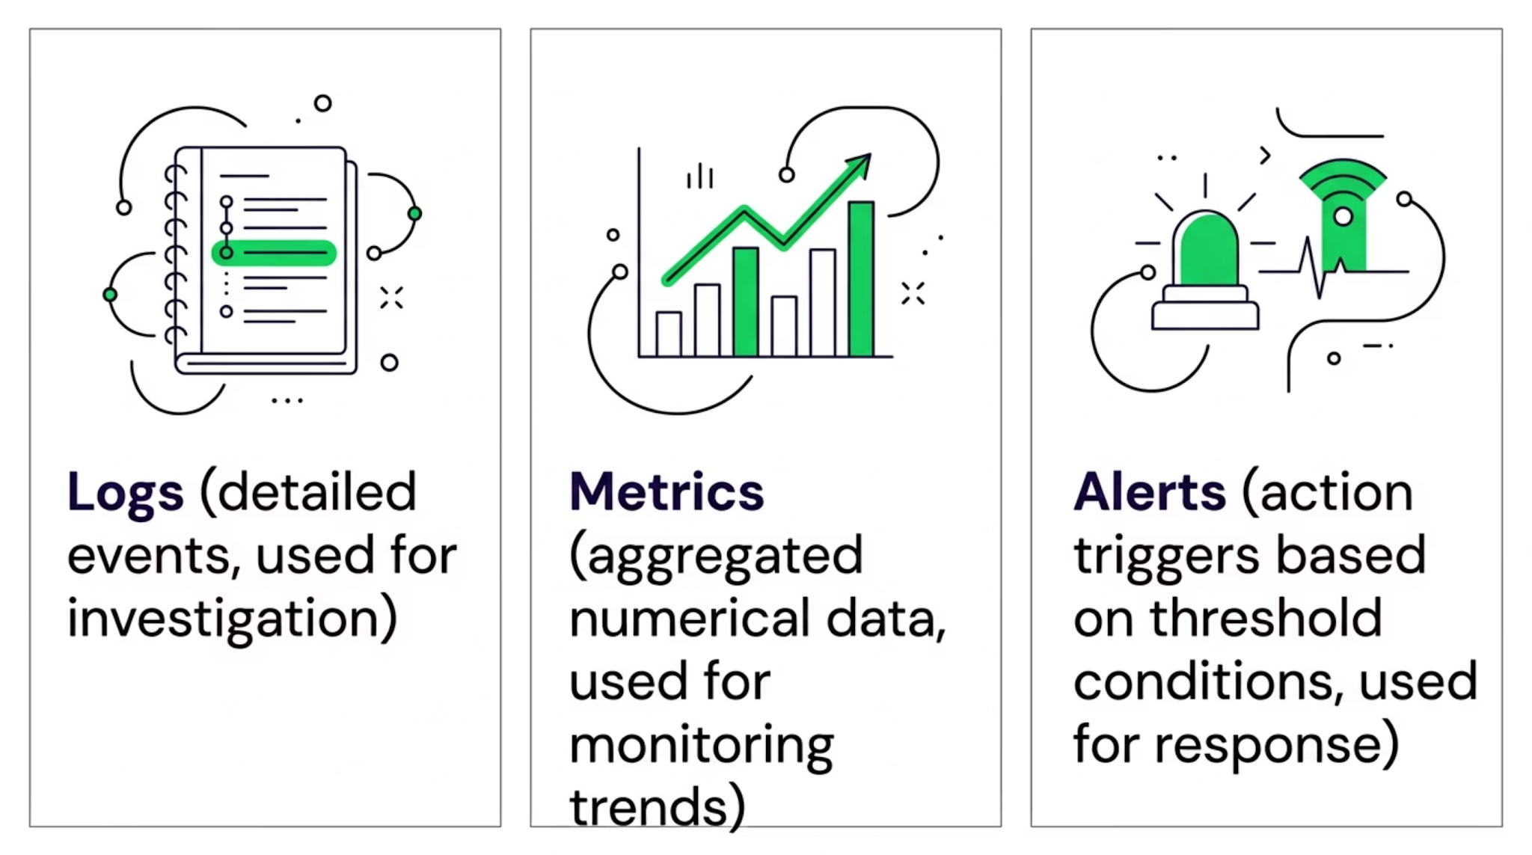
Logs vs Metrics vs Alerts
Logs → Investigation
Metrics → Monitoring
Alerts → Action
Together, these three pillars give complete visibility into system behavior.
8

Slide 9
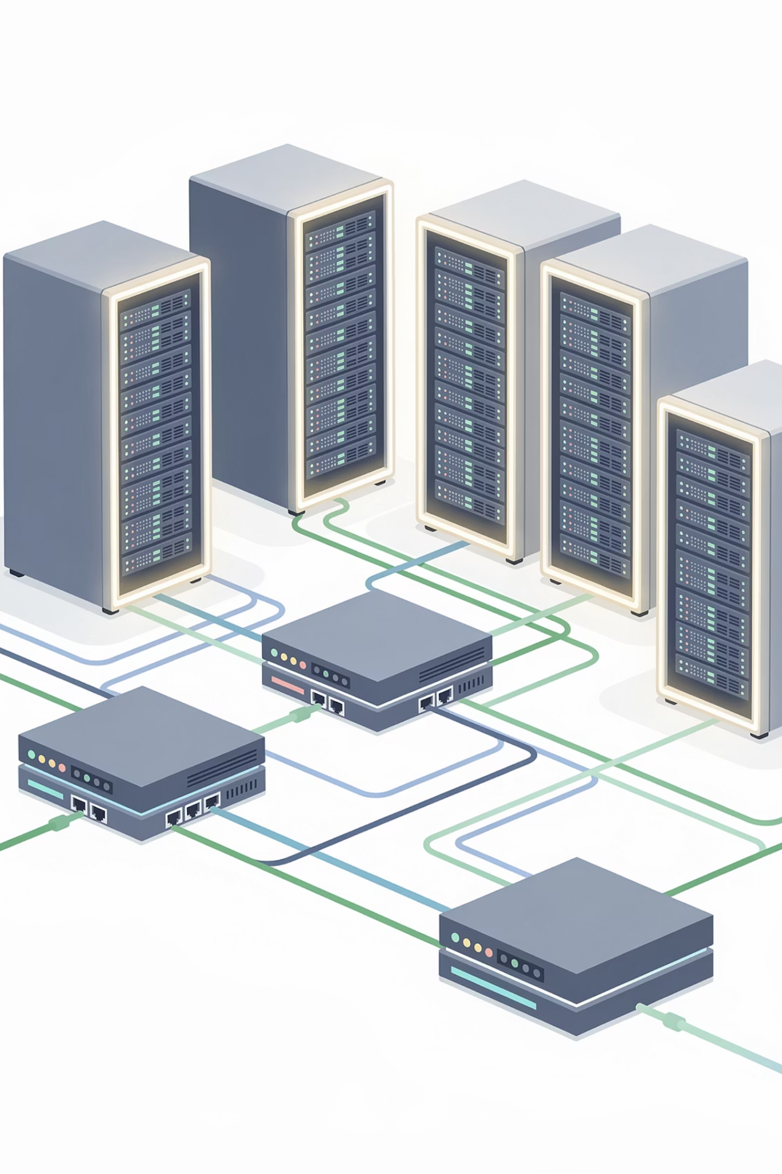
HIGH AVAILABILITY
What is High Availability (HA)?
A system designed to minimize downtime — continuing to work even if one component fails.
Redundancy
Multiple Servers
Load Balancing
Failover Systems
9

Slide 10
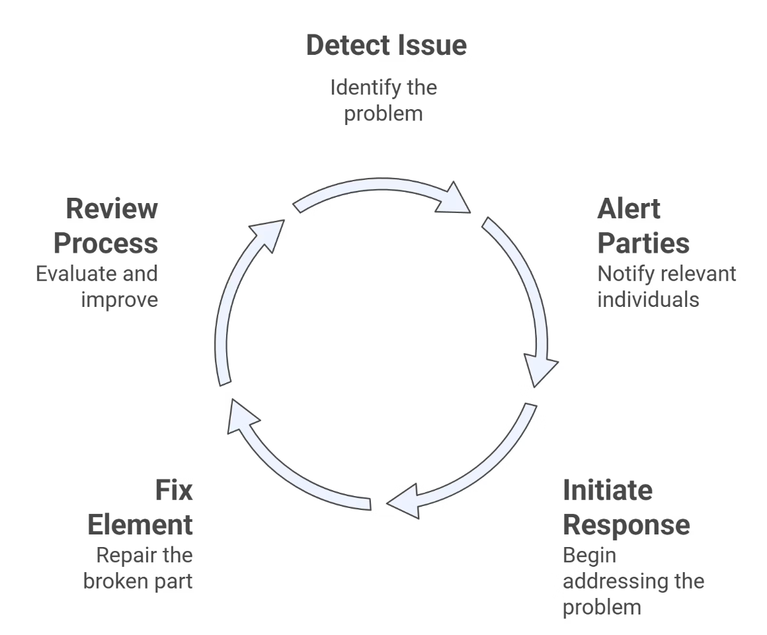

What is Incident Management?
Incident management is the process of handling production issues.
When something breaks:
Incidents will happen.
Prepared teams recover faster.
Key Idea:
10

Slide 11
Mean Time Metrics (Basic SRE Concepts)
Important reliability metrics:
1
2
MTTR – Mean Time To Recover
MTTD – Mean Time To Detect
→ How fast we fix issues
→ How fast we detect issues
Lower MTTR + Lower MTTD = Better reliability
11

Slide 12
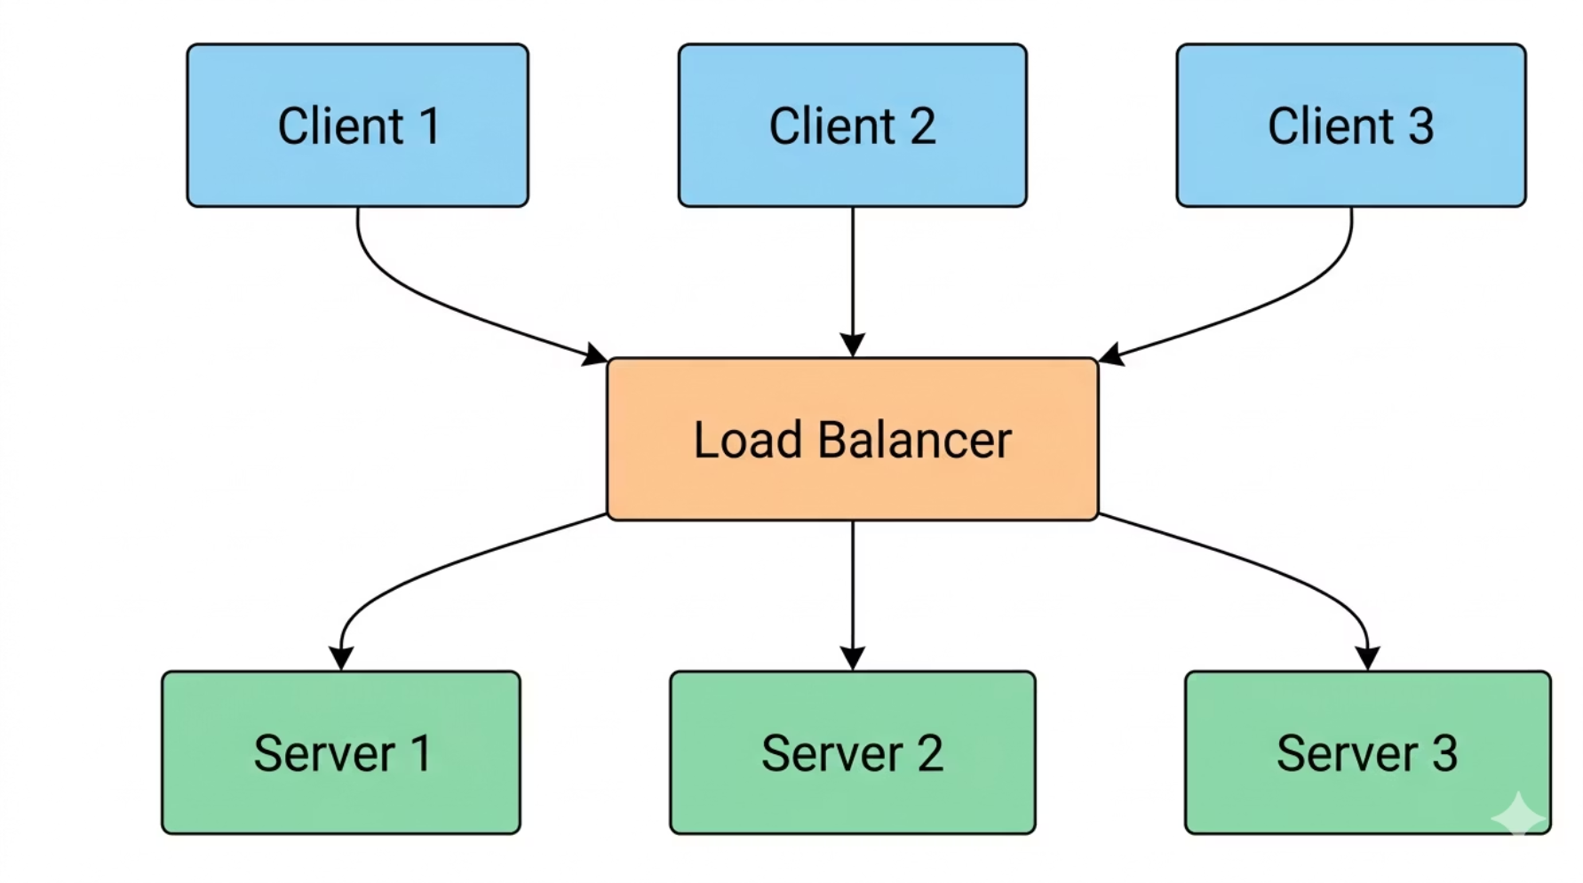
HIGH AVAILABILITY
Example HA Setup
Why This Works
No single point of failure
Traffic is distributed evenly
Database replica ensures data availability
Users experience no interruption
If Server 1 fails → Server 2 handles traffic automatically.
12

Slide 13
SLA & UPTIME
What is an SLA?
Service Level Agreement — defines expected uptime, performance standards, and response times.
Uptime %
Downtime / Year
Requirement
99%
~3.65 days
Basic
99.9%
~8.7 hours
Standard
99.99%
~52 minutes
High-grade architecture
Higher uptime requires better architecture.
13

Slide 14
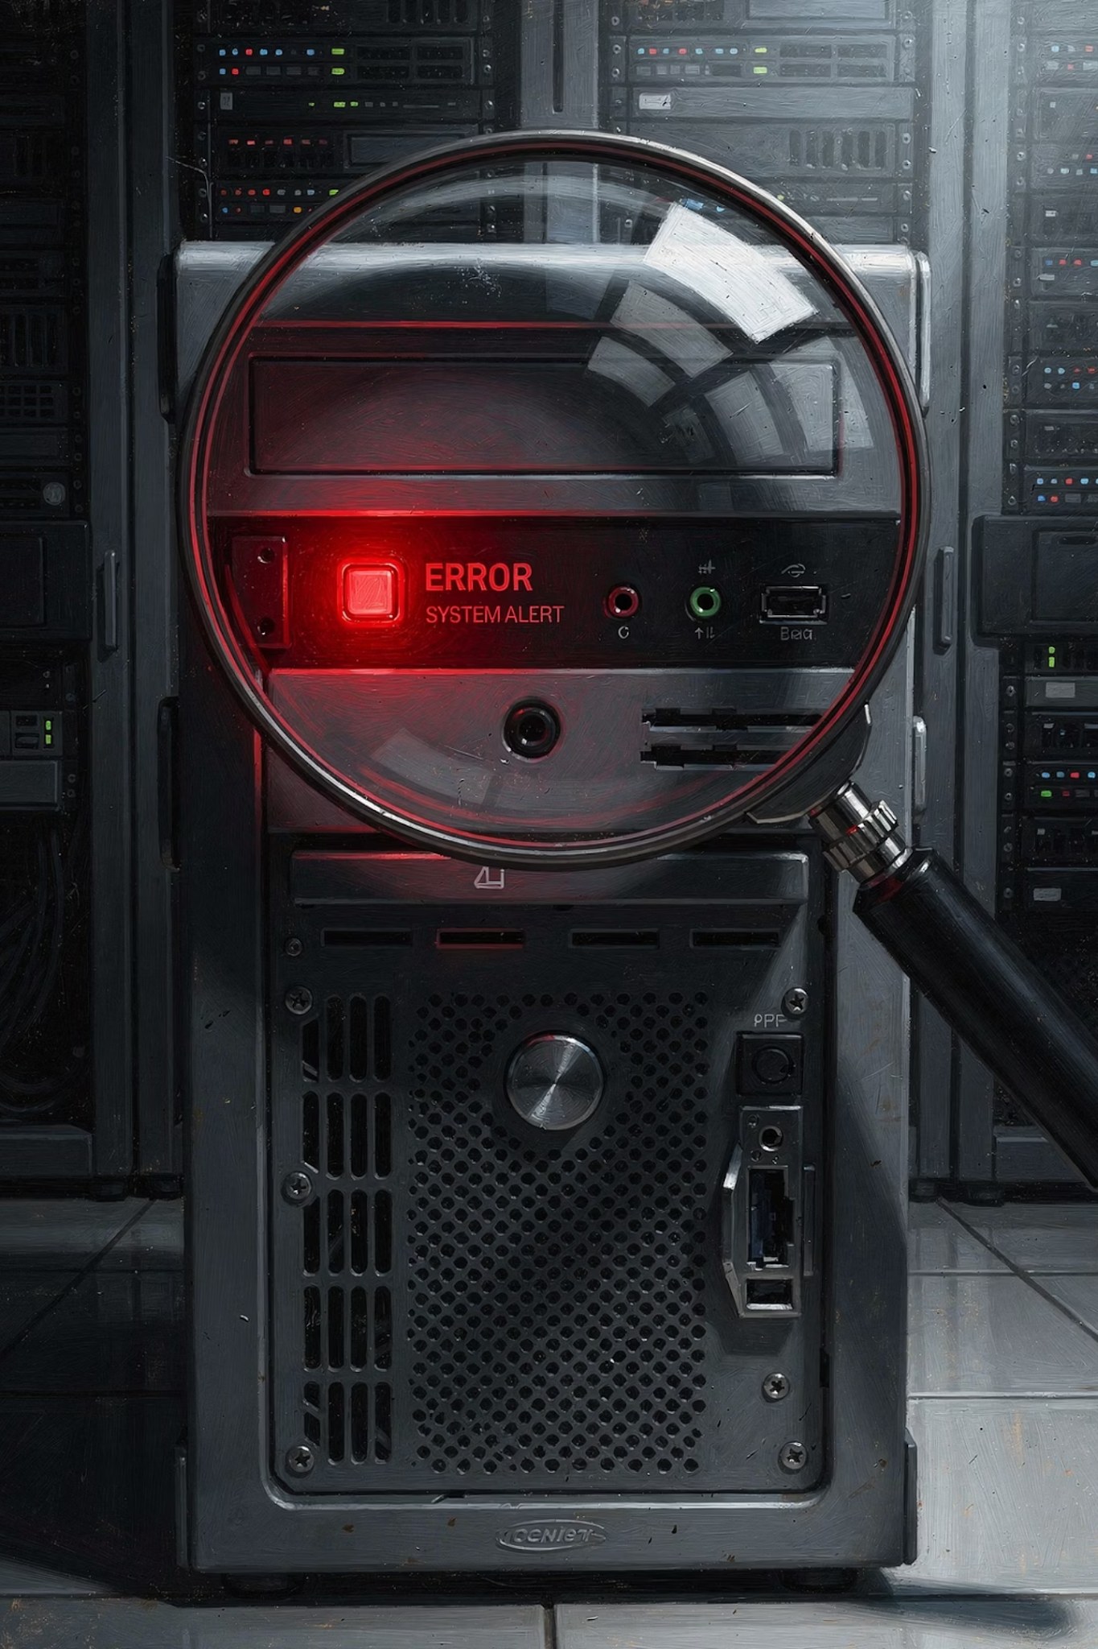
Proactive vs Reactive Monitoring
Reactive Monitoring:
Fix problems after a user complains.
Proactive Monitoring:
Detect early and prevent impact.
Examples of proactive actions:
Alert at 70% CPU instead of 95%
Auto-scale before overload
Restart unhealthy containers automatically
14

Slide 15
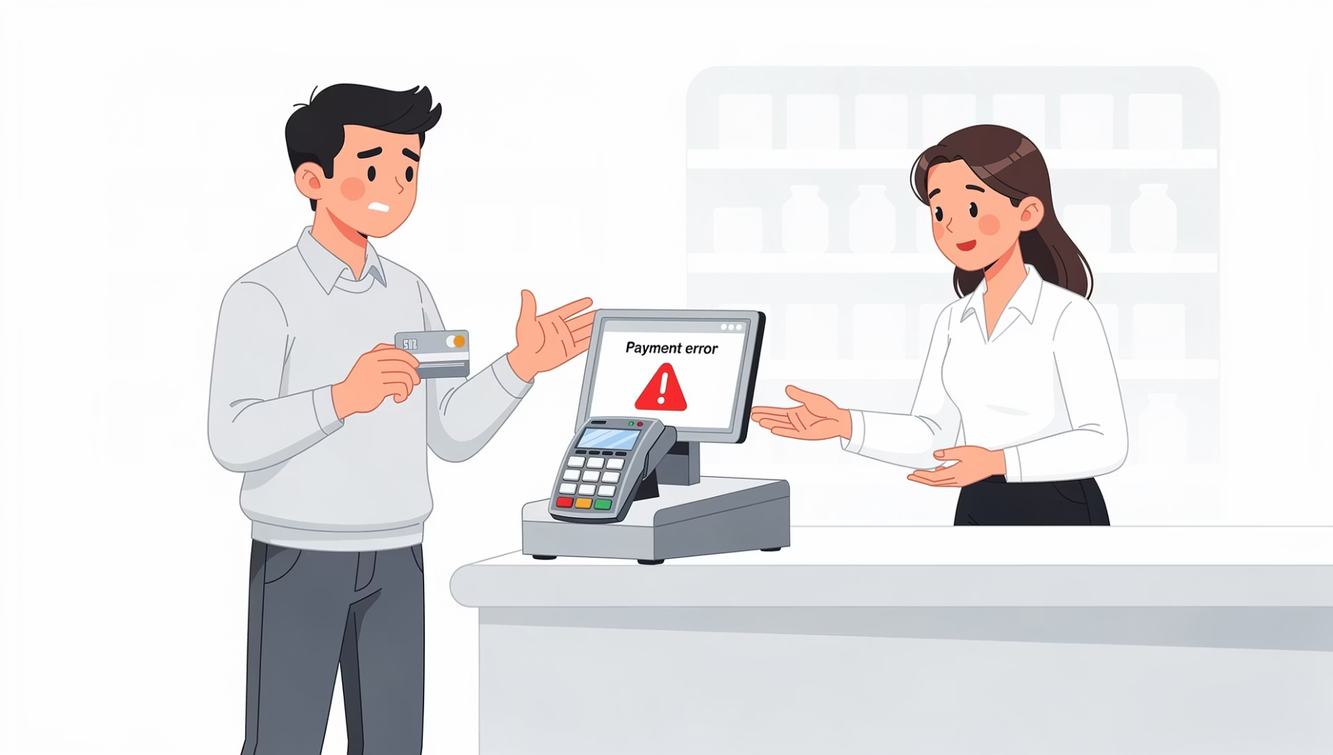
REAL-WORLD EXAMPLES
Payment Gateway Failure
Scenario: Payment service goes down during peak sale.
Impact: Lost revenue, customer frustration, brand damage.
Monitoring should detect:
Payment API failure
Increased error rate
Transaction drop
15

Slide 16

REAL-WORLD EXAMPLES
Server Crash Recovery
Scenario: One server crashes unexpectedly. With HA in place:
1
2
3
Traffic Shifts
Alert Sent
Auto-Restart
Requests automatically routed to healthy server
Team notified immediately via monitoring system
Failed server attempts automatic recovery
Users may not even notice. Fast response reduces downtime.
16

Slide 17

Error Budget Concept
If SLA is 99.9% uptime:
Allowed downtime ≈ 8.7 hours per year.
This allowed downtime is called an “Error Budget”.
If too many failures happen:
Stop new feature releases
Focus on stability
Balance between:
Innovation
Reliability
17

Slide 18
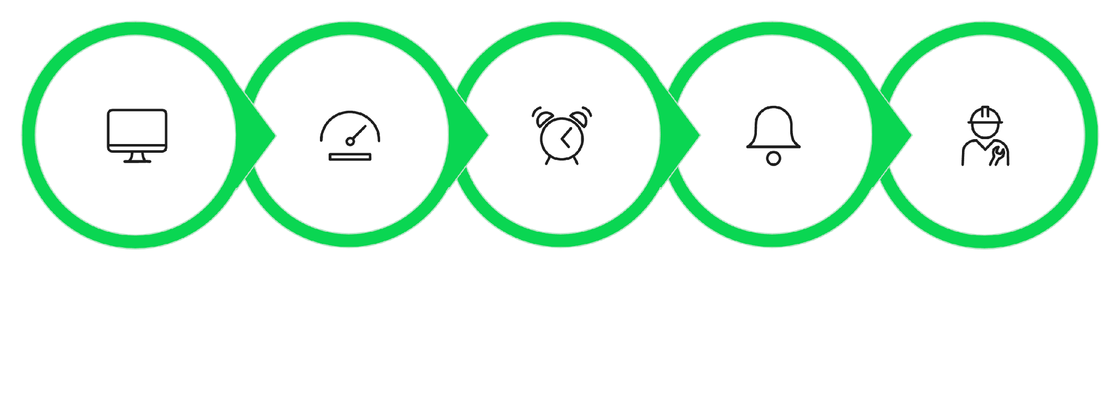





ALERT FLOW
Alert Notification Flow
Monitoring
Threshold
Alert
Notify
Respond
Fast response reduces downtime. Every second counts when a threshold is breached.
18

Slide 19
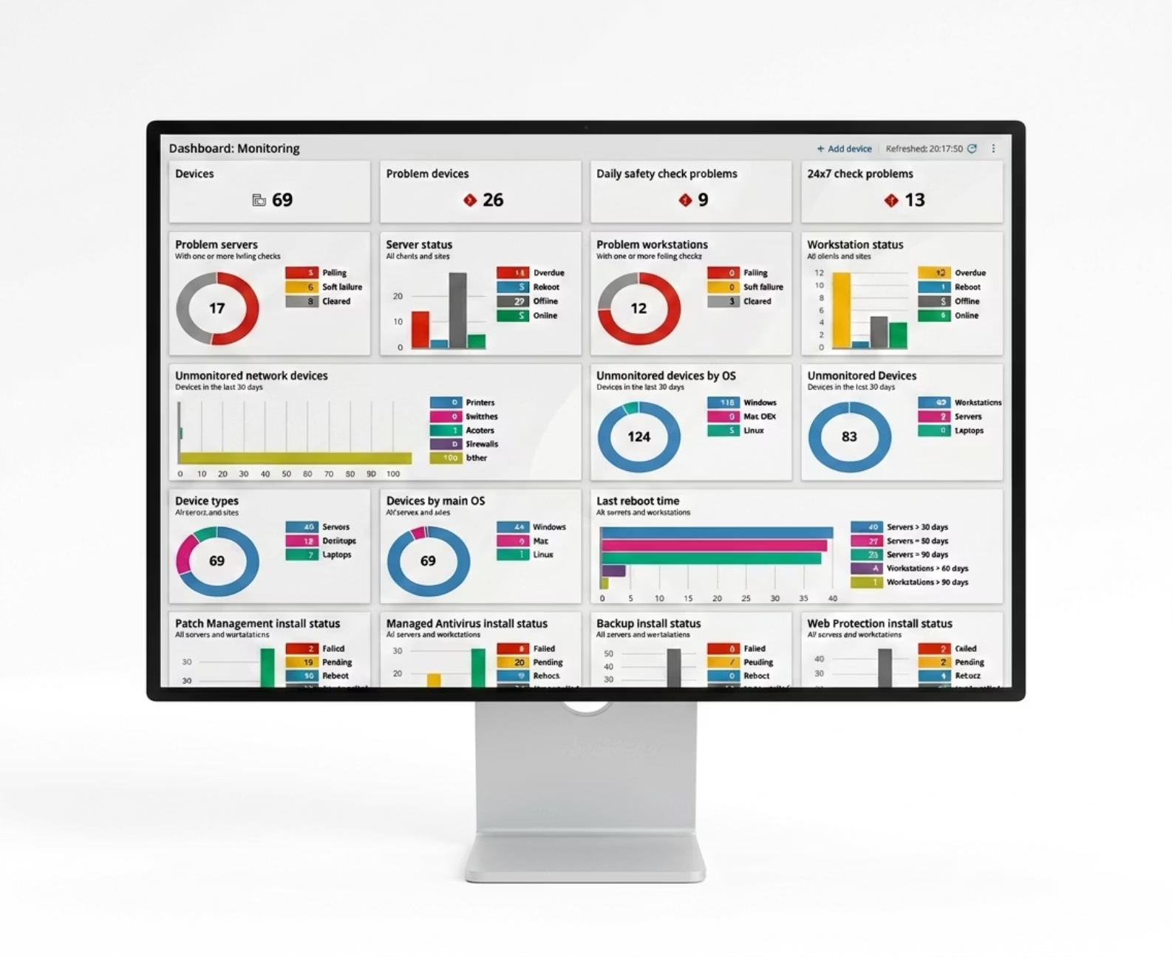
DEMO
Example Dashboard
Dashboard Metrics
CPU usage graph
Memory usage graph
Request rate
Error rate
Response time
Green = Healthy
Yellow = Warning
Red = Critical
19

Slide 20
DEMO
Log File Snippet
2026-02-21 10:15:23 INFO User login successful user_id=102
2026-02-21 10:17:01 ERROR Payment failed transaction_id=8892
2026-02-21 10:18:45 WARN High memory usage detected
INFO
ERROR
WARN
Normal operation
Problem occurred
Potential issue
Logs help in debugging.
20

Slide 21
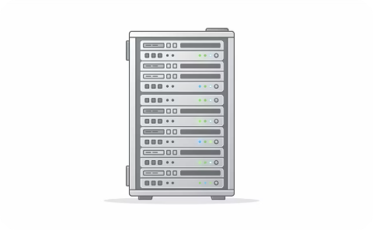
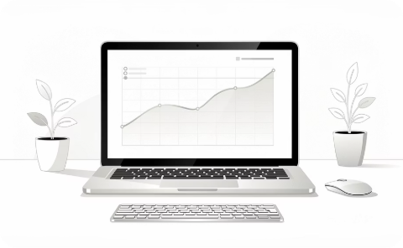
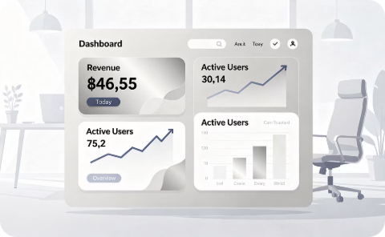
WHAT SHOULD WE MONITOR?
Three Layers of Monitoring
Infrastructure
Application
Business
CPU & memory usage
Disk space & network traffic
Server uptime
Response time & request count
Error rate & API failures
Database query time
Successful transactions
Revenue per hour
Active users & signup rate
Business metrics are equally important as technical ones.
21

Slide 22


MONITORING CHECKLIST
Create Your Monitoring Checklist
Server health
Security events
Application performance
Backup status
Error tracking
SSL certificate expiry
Database performance
External service dependencies
Monitoring should cover both technical and business metrics.
22

Slide 23
SCENARIO DISCUSSION
Your E-Commerce App Slows Down
What do you check first? Think through the possibilities logically:
1
2
3
CPU
Memory
Database
Is compute maxed out?
Is RAM exhausted?
Slow queries or locks?
4
5
Network
Deployment
Latency or packet loss?
Recent code change?
23

Slide 24
The Reliability Mindset
Reliable systems don't happen by accident — they require continuous effort.
Monitoring
Alerts
Redundancy
Backup
Incident Response Plan
24

Slide 25
Key Takeaways
1
Monitoring
Continuously observe system health to detect issues early.
2
Logs, Metrics & Alerts
Three pillars: investigate, monitor, and act.
3
High Availability
Redundancy and failover keep systems running.
4
SLA & Uptime
99.99% uptime demands superior architecture.
5
Reliability Mindset
Monitoring + alerts + redundancy + incident response = resilience.
25

Slide 26


Thank You
26

